Slide 1
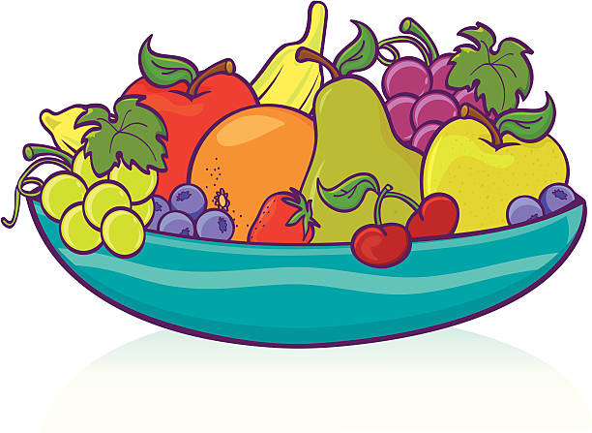
LO: To say food items in French
Can you work out what these food items are in English? Answers below
les oranges
les poires
les prunes
les fraises
les pommes
les tomates
les bananes
Click the sound icon to hear how to say each word.
Task: Draw a picture of the food items and label it with the French.

Slide 2
Food Item Answers
les oranges - oranges
les poires - pears
les prunes - plums
les fraises - strawberries
les pommes - apples
les tomates - tomatoes
les bananes - bananas

